Slide 1
Student Admissions Classifier Project
AI Fundamentals
Calvin Goins & Adam Blackwell
Notes:
Draft Presentation Plan:
Slide 1: Adam
Slide 2-6: Calvin
Slide 7-12: Adam
Adam: Speaker Notes:
Hey everyone, Calvin and I will be spending the next 5-10 minutes presenting four parts of our Scikit-Learn Admissions Classifier project & showing off a quick demo.
At a high level we wanted to use machine learning to predict whether a student gets admitted based on some academic metrics.
I’ll hand the mic over to Calvin to share more about the four parts of our presentation.
You can say next when I should go to the next slide

Slide 2
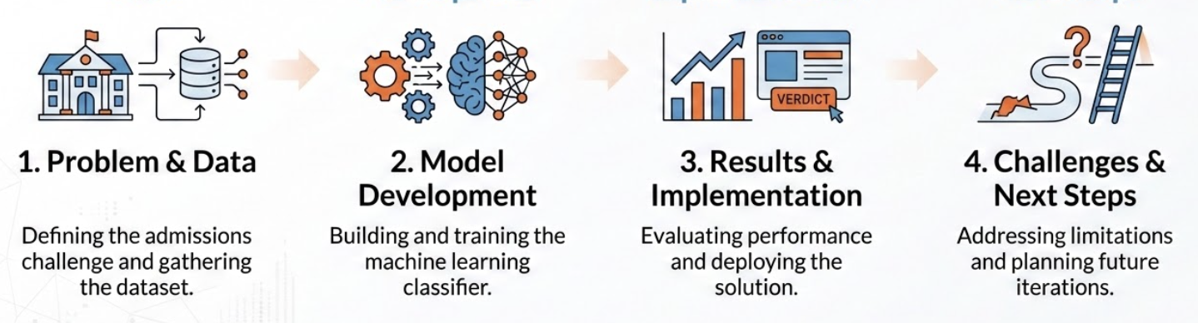
What We’ll Be Presenting
1. Problem & Data
2. Model Development
3. Results & Implementation
4. Challenges & Next Steps
Notes:
Calvin: Speaker Notes:
First, we’ll talk about the problem and the dataset we used.
Then we’ll explain how we built the model using Scikit-Learn and why we chose Logistic Regression.
After that, we’ll show you how our ML pipeline works and talk about what we’d do to improve it.
Notes Not To Be Read:
Problem & Data (3-5)
300 Kaggle applications (GPA, SAT, extracurriculars)
Model Development (
Logistic Regression with standardized features
Results & Implementation
65% accuracy & CLI prediction tool
Challenges & Next Steps
Limits of small data; Neural Networks overfit and underperformed

Slide 3
Predictive Modeling for Admissions
Objective: Develop a machine learning pipeline to predict university admission outcomes.
Methodology: Logistic Regression classification using academic & extracurricular metrics.
Core Stack: Python, Scikit-Learn, Pandas
Source: github.com/adzuci/admissions-classifier
Notebook: bit.ly/followalongwithushere
Notes:
Problem & Data
Calvin: Speaker Notes:
So to get started we approached this as a supervised classification problem and after doing some testing decided to use Logistic Regression.
We implemented the full workflow in Python using Pandas for data handling and Scikit-Learn for modeling.
Our focus was building a clean, reproducible pipeline from training to ‘deployment’ so we could shift between models and improve it over time.

Slide 4
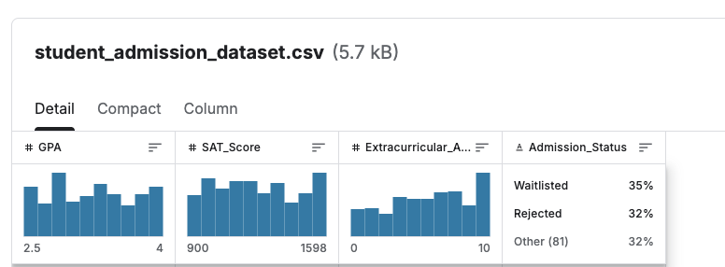
The Foundation of the Model
Primary Dataset Features:
  GPA (2.5–4.0)
  SAT Score (900–1600)
  Extracurriculars (0–10)
Output: Accepted, Waitlisted, Rejected
Data Source: Kaggle Student Admission Dataset
Notes:
Calvin: Speaker Notes:
So at the core of our pipeline is a Kaggle dataset of 300 applications
The three main features were GPA, SAT score, and extracurricular involvement.
The Output options were Accepted or Waitlisted/Rejected

Slide 5
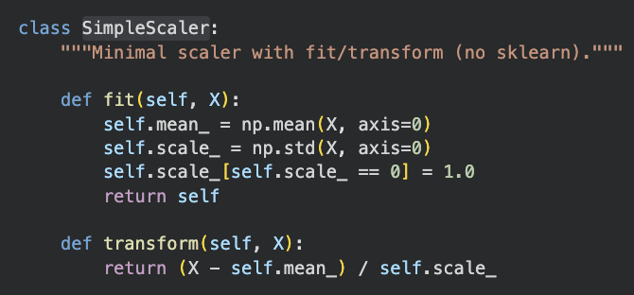
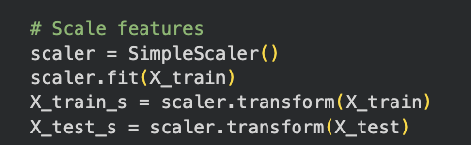
Exploratory Data Analysis
Preprocessing: Applied StandardScaler to normalize GPA & SAT variance.
Target Engineering: Converted categorical outcomes to binary classification.
Correlation Analysis:
  Extracurriculars shift admission threshold.
  Strong SAT can offset lower GPA in some cases.
Notes:
Model Development
Calvin: Speaker Notes:
Because SAT scores are on a much larger numeric scale than GPA, we used a StandardScaler (seen on the right here) so one feature wouldn’t dominate the model.
We also converted the original labels into a binary classification problem by grouping Waitlisted and Rejected together to simplify training.

Slide 6
Model Training
Training Command: python admissions.py --train
Test Accuracy: 0.6531 (65.31%)
Model Persistence:
  model.joblib
  scaler.joblib
Ensures reproducibility between training and inference.
Notes:
Calvin: Speaker Notes:
Training the model is straightforward with python admissions.py --train
We achieved about 65% accuracy on the test set using logistic regression.
We also save the trained model as a .joblib file. That way, when we run predictions later, we don’t need to retrain.
This ensures consistency and reproducibility between training and inference.
And now over to Adam.

Slide 7
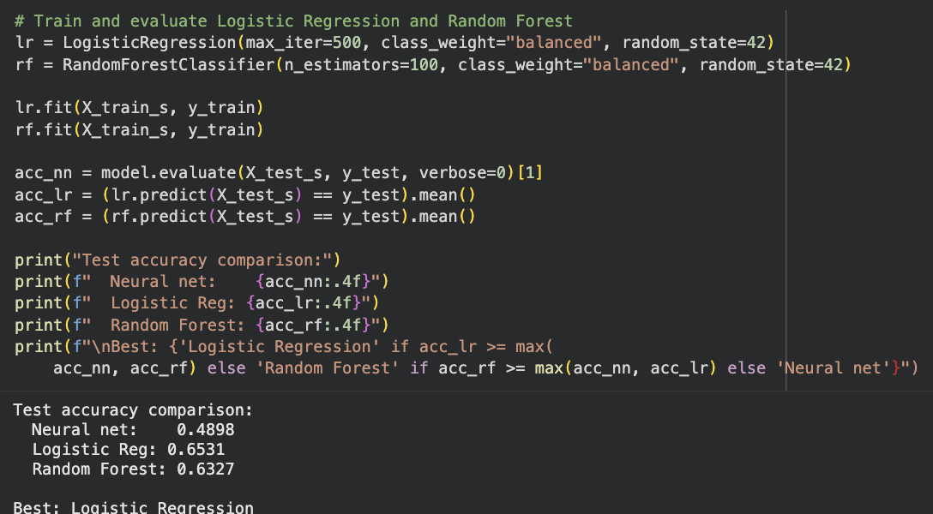
Why Logistic Regression?
Interpretability: Clear coefficients show impact of GPA vs SAT.
Efficiency: Lightweight, CPU-only, minimal memory footprint.
Probability Output: Produces 0–1 score useful for waitlist thresholds.
Results: After training using three models it was the most accurate, which we believe is due to the small dataset
Notes:
Adam: Speaker Notes:
We chose Logistic Regression because it’s interpretable,
lightweight,
and it gives probability outputs,
Also when we compared it to using a neural net or random forest model, it performed the best on our small dataset.

Slide 8
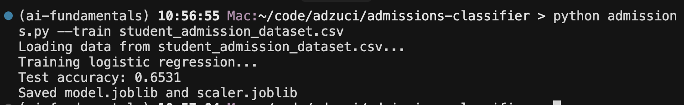
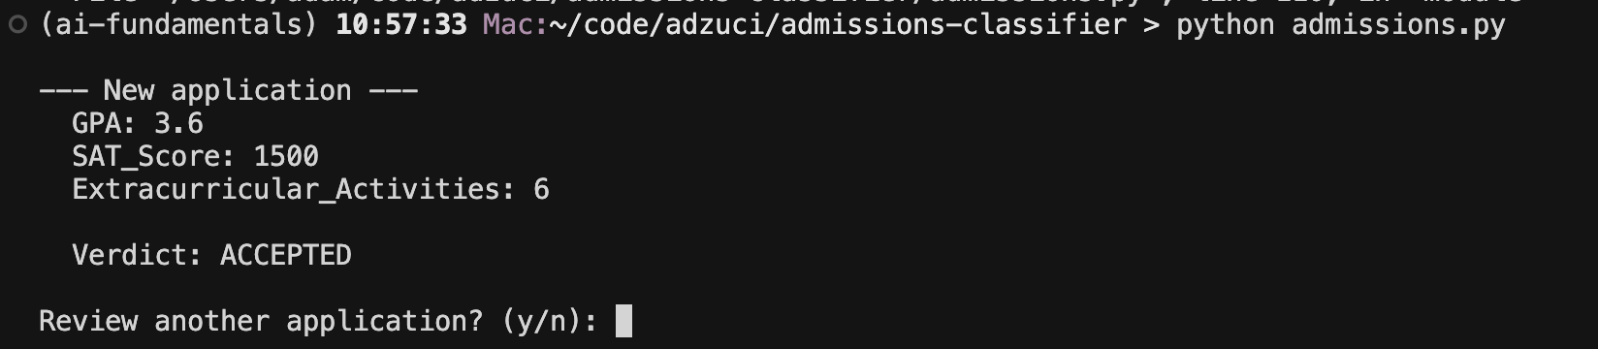
The admissions.py Code
Loads serialized model and scaler.
Accepts user input for GPA, SAT, and extracurricular count.
Returns immediate admission verdict.
Supports rapid 'what-if' experimentation.
Notes:
Adam: Speaker Notes:
This script either trains the model or loads the saved model depending on the –train flag
Without the –train flag it prompts the user for GPA, SAT score, and and number of extracurriculars.
Then it returns an admission verdict.

Slide 9
Demo
Notes:
Adam: Go to https://colab.research.google.com/github/adzuci/admissions-classifier/blob/main/admissions_classifier.ipynb#scrollTo=Y9c8Zg2IzY56 & then run the script in the terminal.

Slide 10
Open Questions
How do we prevent encoding historical bias in training data?
What features could be added?
How could we transition the CLI to a cloud-hosted API?
Notes:
Adam: Speaker Notes
How do we prevent encoding historical bias in training data?
What features could be added?
Years of experience?
Recommendation letter sentiment?
How could we transition the CLI to a cloud-hosted API?

Slide 11
Roadmap & Conclusion
Hosting: Azure or AWS.
Data: More features, larger training dataset.
UI/UX: Streamlit dashboard.
CI/CD: Automate retraining when dataset updates.
Key Takeaway: We built an end-to-end, interpretable ML pipeline ready for iteration.
Notes:
Adam: Speaker Notes
If we continued this project, the next steps would be deploying to, adding more data and features, and possibly building a Streamlit dashboard for live demos.
We’d ideally also automate retraining with CI/CD.
In conclusion, using the knowledge gained from this class we built a complete, interpretable ML pipeline that’s ready to be iterated on.

Slide 12
Q&A

Slide 13
1
Problem & Data

